Slide 1
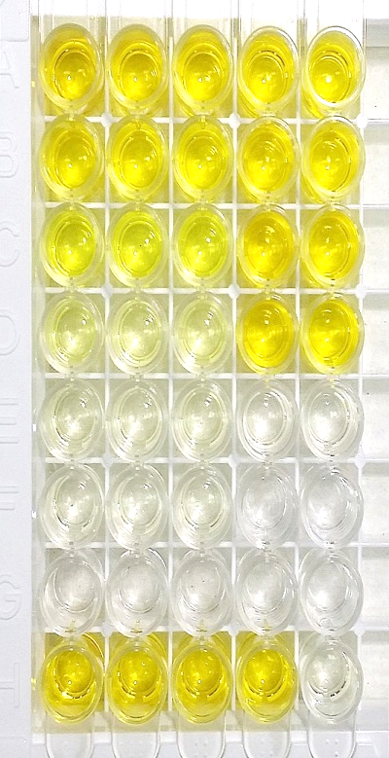
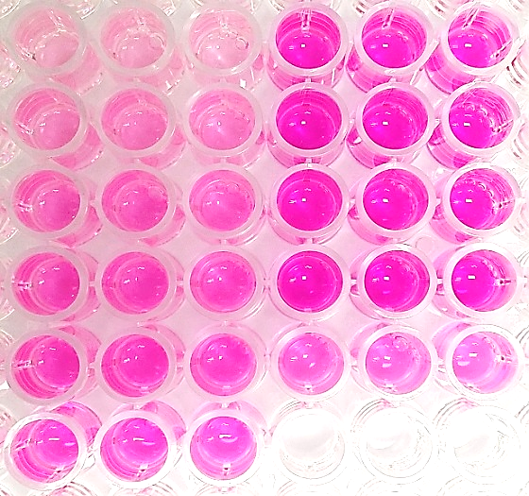
A
Standard
Sample
B
Standard
Sample
ng/ml
n mol
200
Day 2 M miHep
0
Day 2 M miHep
50
Day 2 F miHep
1
Day 2 F miHep
12.5 l
Day 3 M miHep
2
Day 3 M miHep
3.125
Day 3 F miHep
3
Day 3 F miHep
0.781
iHep Medium
4
iHep Medium
0
5
Day 2 M miHep
Day 2 F miHep
Day 3 M miHep
Day 3 F miHep
iHep Medium
Supplementary figure 1
Notes:
1.A. Mouse Albumin ELISA analysis

Slide 2
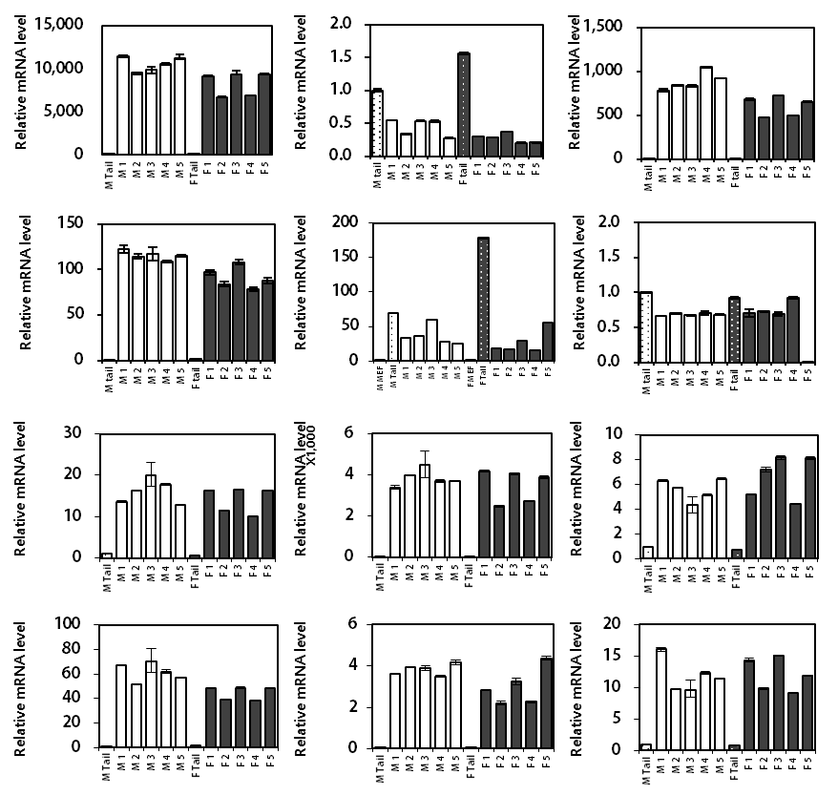
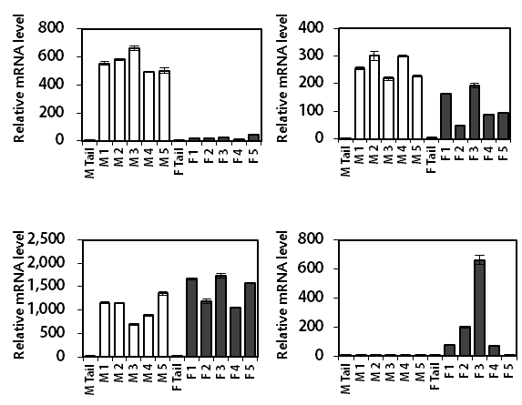
A
a. mAlb
b. mAfp
c. mAat
C
a. mCyp2d9
b. mCyp8b1
d. mTrf
e. mEcad
f. mVim
c. mCyp2a4
d. mCyp3a41
B
a. mCyp1a1
b. mCyp1a2
c. mCyp2a5
Male MEF
d. mCyp2d22
e. mCyp3a11
f. mCyp3a13
Female MEF
Male Tail
Female Tail
Male Liver
Female Liver
Supplementary figure 2

Slide 3
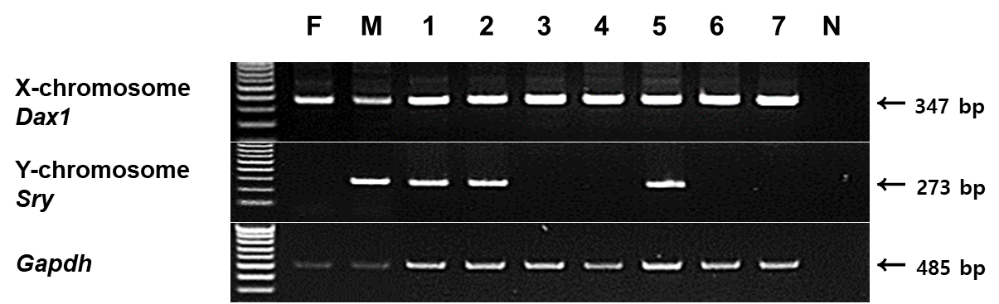
A
F : Female genomic DNA, Positive control
M : Male genomic DNA, Positive control
1-8 : # 1-8 MEF genomic DNA
N : Genomic DNA contamination control
B
a. Male MEF
b. Female MEF
Supplementary figure 3

Slide 4
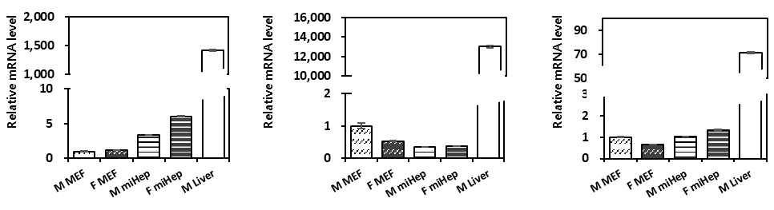
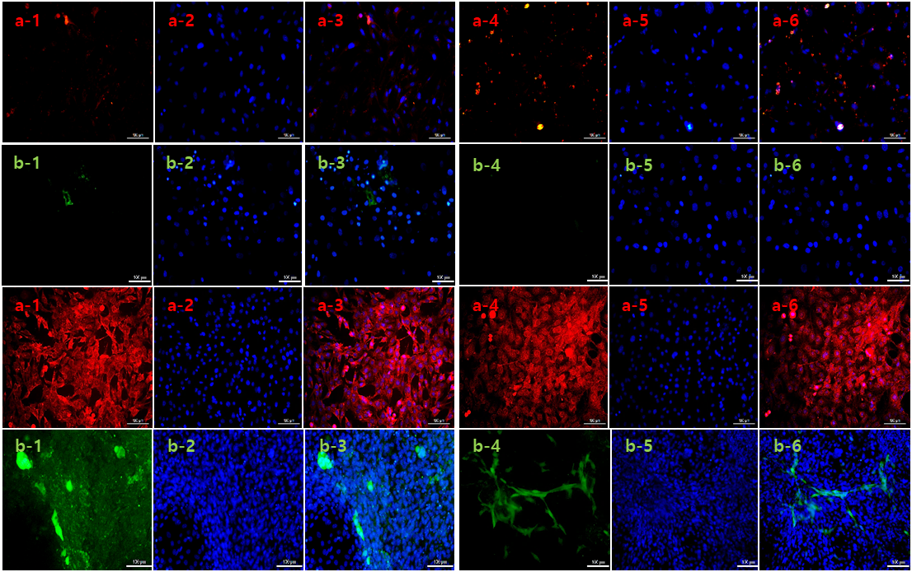
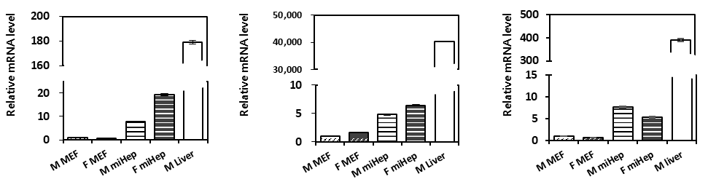
A
B
Male
Female
DAPI
Merge
DAPI
Merge
Cyp3a11 / Cyp1a2/1a1
Cyp3a11 / Cyp1a2
a. mCyp1a1
b. mCyp1a2
c. mCyp2a5
e
d
d
c
d
c
b
a
b
a
b
c
A. MEF
a
b
a
d. mCyp2d22
e. mCyp3a11
f. mCyp3a13
e
e
e
d
d
d
b
c
b
c
b
a
c
B. miHep
a
a
Supplementary figure 4

Slide 5
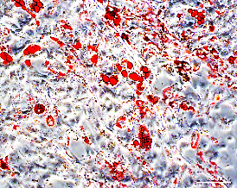
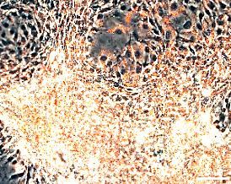
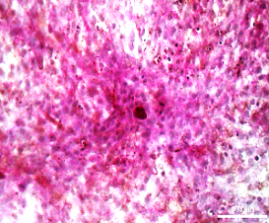
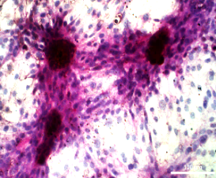
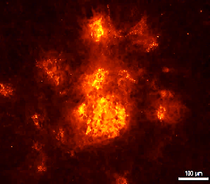
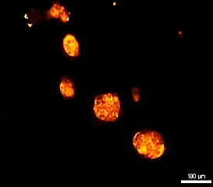
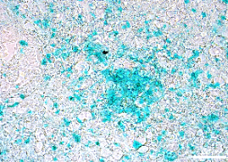
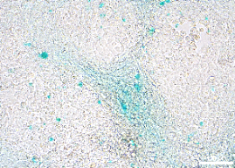
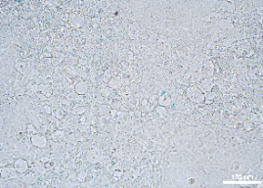
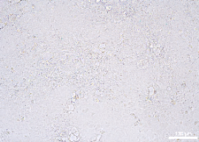
A
Male
Female
B
a. mLpl
b. mPparγ
a. Oil red O
*
*
*
*
*
d
Relative mRNA level
e
b. PAS
Relative mRNA level
*
c
a
c. Dil-Ac-LDL
Male MEF
Female MEF
Male miHep
Female miHep
M Liver
d-1. ICG upake
d-2. ICG release
Supplement figure 5

Slide 6
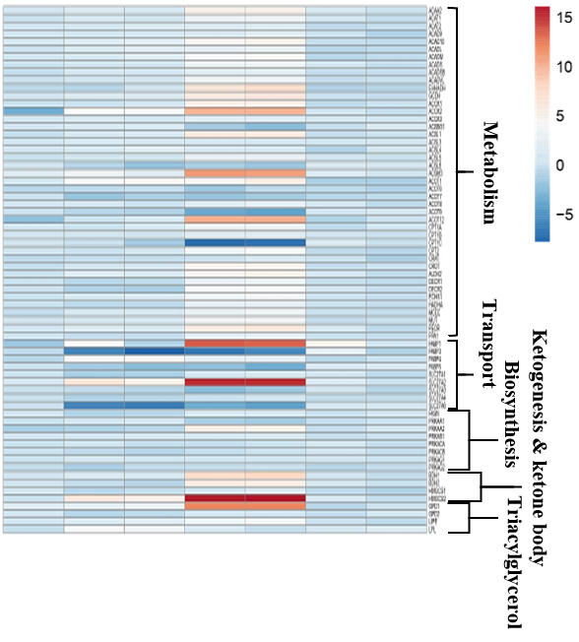
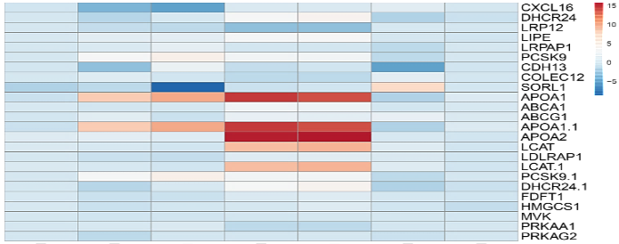
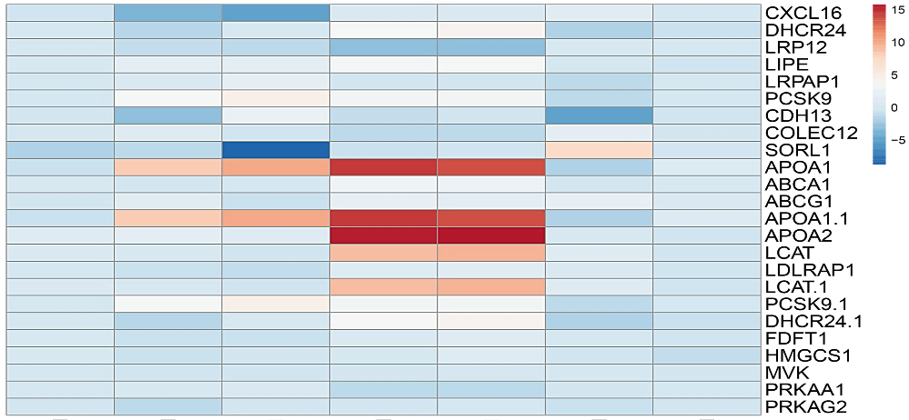
Glucose/Glycogen metabolism
Fatty acid metabolism
A
B
M MEF
M miHep
F miHep
M Liver
F Liver
M miHep / F miHep
M Liver / F Liver
Lipoprotein/Cholesterol metabolism
C
Normalization to F MEF
M MEF
M miHep
F miHep
M Liver
F Liver
M miHep / F miHep
M Liver / F Liver
Normalization to F MEF
Supplementary figure 6

Slide 7
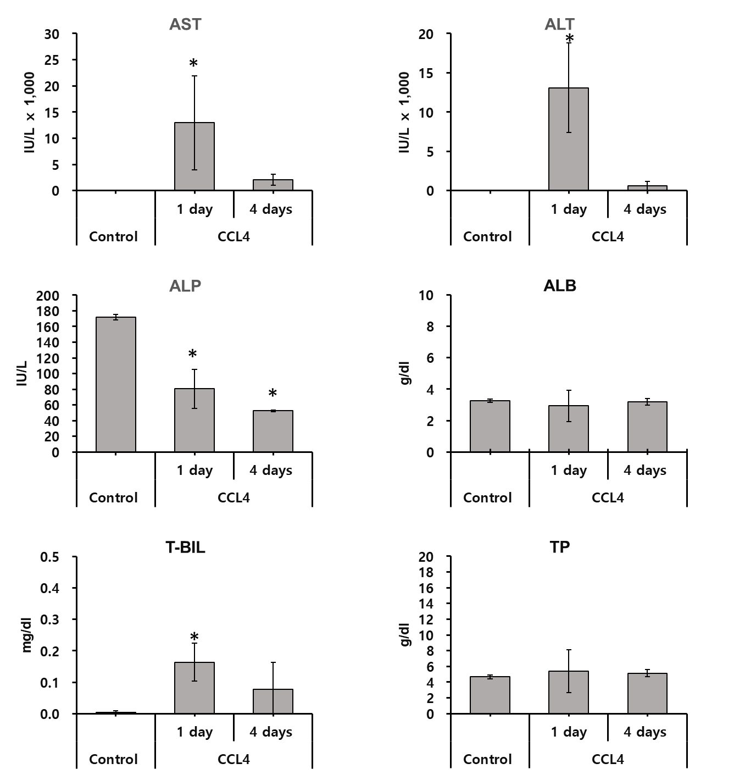
A
a
b
c
e
Supplementary figure 7

